Slide 1


Slide 2
ORPHAN FOUNDATION SYSTEM Guided by, Santosh Mali Sir
ENTROLLMENT NUMBER | STUDENT NAME
(EBEON0721404916) | KRISHNA PRASANNA D
(EBEON0721397667) | SYED SAFRIN ARAFA S
(EBEON0721396924) | VEMBULAKSHMI R

Slide 3
CONTENTS
INTRODUCTION
MODULES
TECHNOLOGIES
CONCLUSION

Slide 4
INTRODUCTION
An orphanage is a place where children without parents are cared for and housed and also due to children in some financial needs or family problems.
The Orphan having idea to help these children and educate them .
An Orphan provide care, support and protection to the children through shelter, food and education.

Slide 5
AIMS & OBJECTIVES
To donate through online for the orphanage children who lost their parents ,shelter ,accommodation .

Slide 6
MODULES
MAIN PAGE
HOME PAGE
NEEDS
ABOUT US
CONTACT
DONATION
CONCLUSION

Slide 7
TECHNICAL SPECIFICATION
1.HTML-Hyper Text Markup Language
- Structure of the page.
2.CSS-Cascading Style Sheets
- Used to Style the Page.
3.JAVASCRIPT
- Behaviour of the page.
4. CORE JAVA.
IDE
1.Eclipse.

Slide 8
MAIN PAGE
Main page Developed by R.Vembulakshmi
This Page is the main web page of a website
In Main Page, the details of our needs , contact us , about us and also having donation page

Slide 9


Slide 10
HOME PAGE
Home Page Developed by S.Syed Saffrin Arafa
Orphans in orphanages are given a safe environment in which to grow, given some regular food and schooling.
In this page, JavaScript is used for Automatic Slide Show images of the Orphanage.

Slide 11
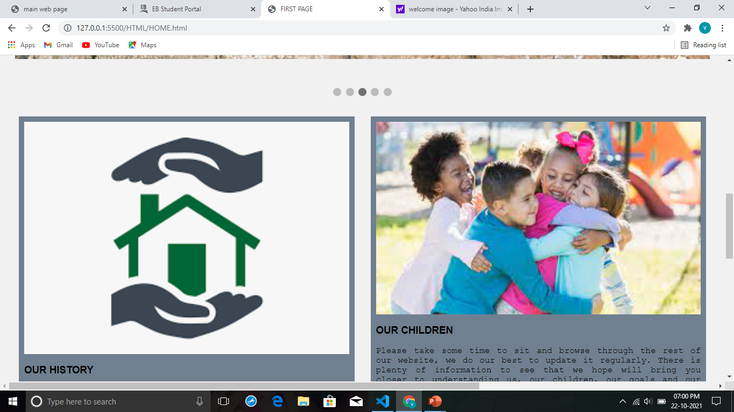

Slide 12
NEEDS
Needs Page Developed by D.Krishna Prasanna
This is a platform that is very beneficial for orphaned children.
This page is used to check the needs of an Orphanage like food , health benefits and education.

Slide 13
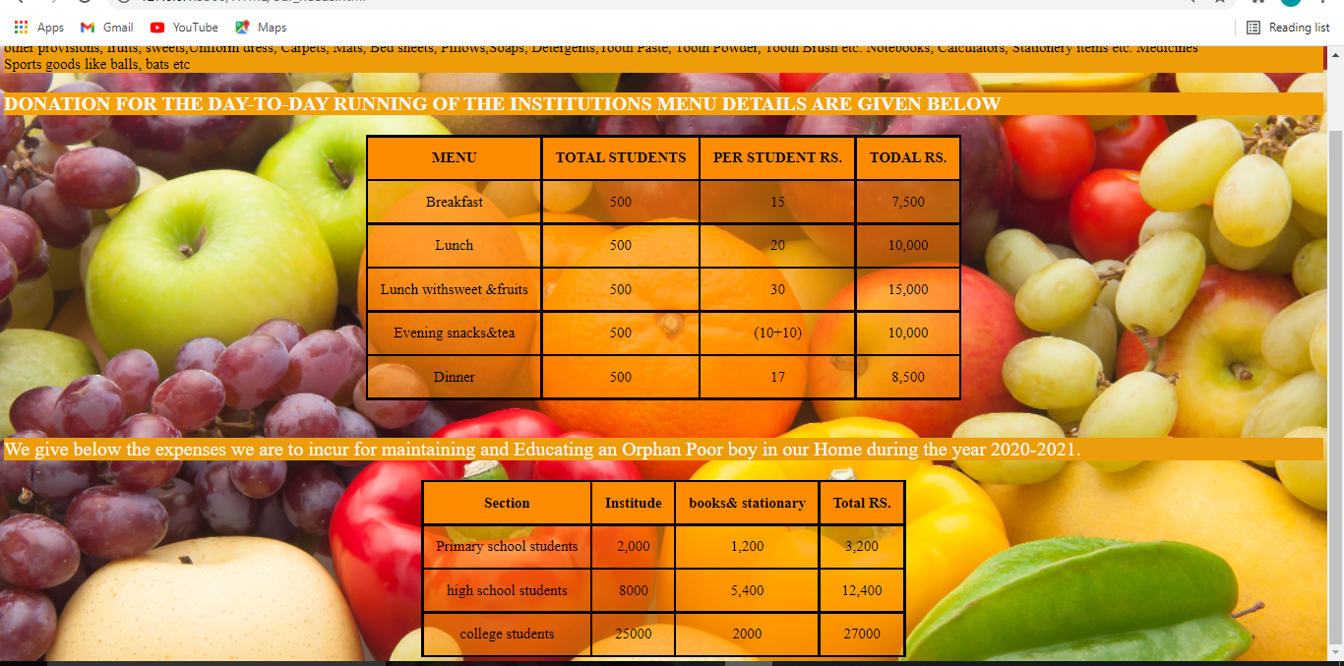

Slide 14
ABOUT US
About us page Developed by S.Syed Saffrin Arafa
In this page , used to know about the mission of orphanage and here blur background image and internal CSS are used.

Slide 15
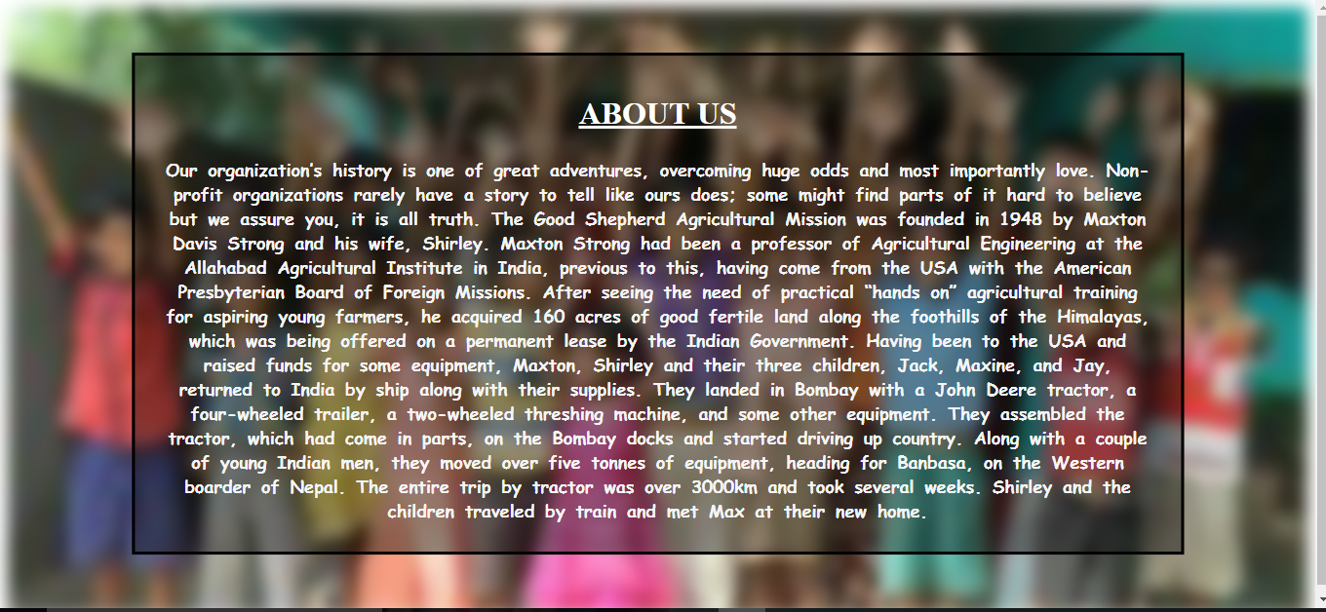

Slide 16
CONTACT
Contact us page Developed by R.Vembulakshmi
If anyone would like to contact our organization, they can contact us through Phone number, Mail, Message, WhatsApp, Twitter etc..
Here , direct message option facility also available in this page , using this option the can share their thoughts, questions , queries directly.

Slide 17
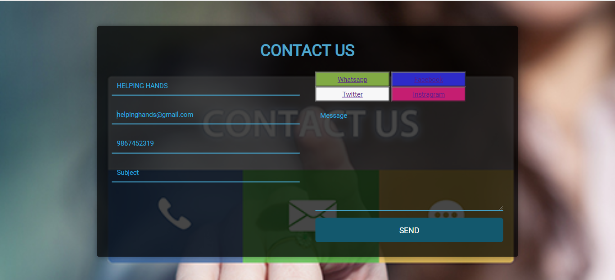

Slide 18
DONATION
Donation page Developed by D.Krishna Prasanna.
Online donation is possible in our project.
We can help a child to escape from the bonds of poverty through our donation online.
Your donation will ensure that the children receives Education, Healthcare as well as some support through every phase of the child life.

Slide 19
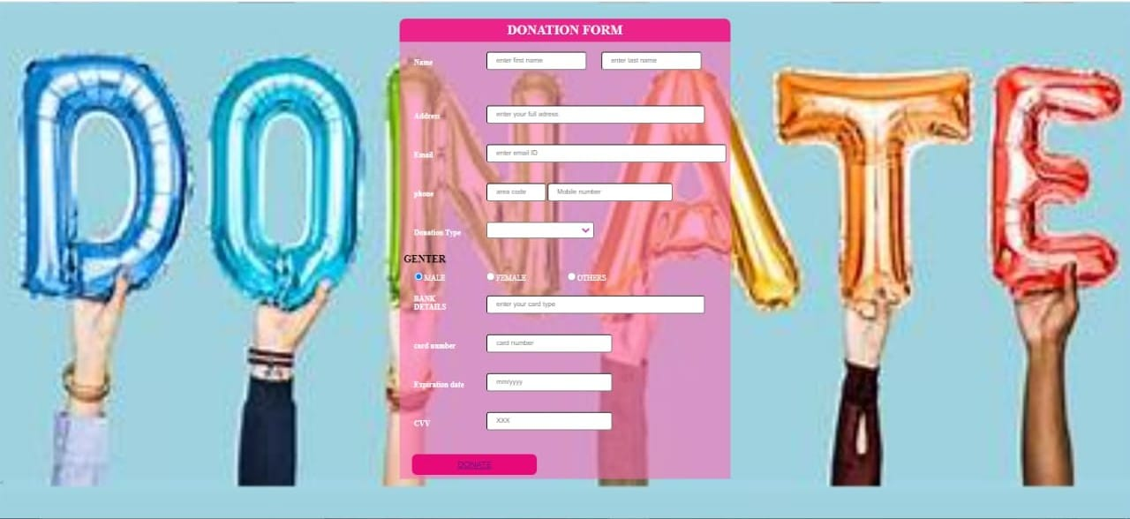

Slide 20
CONCLUSION
It will help to improve the current situation of orphan child and give them needed help that they deserve.
The donation online portal as the social platform to improve the current condition of orphans.

Slide 21


